Slide 1


PRESENTING MOODTALK

Slide 2


EMOJI ONLY MESSENGER WEBSITE
<💡>
PRESENTED BY:
CODE INNOVATORS

Slide 3



OUR FEATURES
Enhancing emotional expression through emojis
transparency in data handeling
real time message encryption

Slide 4

1# UNDERSTANDING THE RISE OF EMOJI USAGES
Emojis Enhance Digital Clarity
The integration of emojis in digital communication significantly improves clarity and emotional expression, reducing the likelihood of misinterpretation in text-based interactions.

Slide 5
Reducing the barrier
An emoji-only messenger breaks language barriers by using universal symbols, making communication faster and more inclusive.
Secure and Safe Chat
Hashing passwords and usernames enhances security by storing irretrievable hashes instead of plain text, protecting data even if the database is compromised.

Slide 6

TECHNOLOGY STACK
FRONTEND
HTML, CSS, JAVASCRIPT .
Secure and Safe Chat
Python, Flask.

Slide 7

SOURCE
USED
IN
PROJECT

Slide 8


TOPIC #2
All the sources used
GitHub Repositories:
Flask Login:– Integrates hashed password system in Flask.
JWT Auth: – JWT with hashed passwords.
Emoji Messenger: – Example of an emoji-only messenger app.
ChatGPT Discussions:
Password Hashing: "How to hash passwords securely?"
Emoji Messenger: "Best practices for building an emoji-based app?"
Documentation:
OWASP Password Storage: OWASP Cheat Sheet.
Flask Authentication: Flask Tutorial.

Slide 9
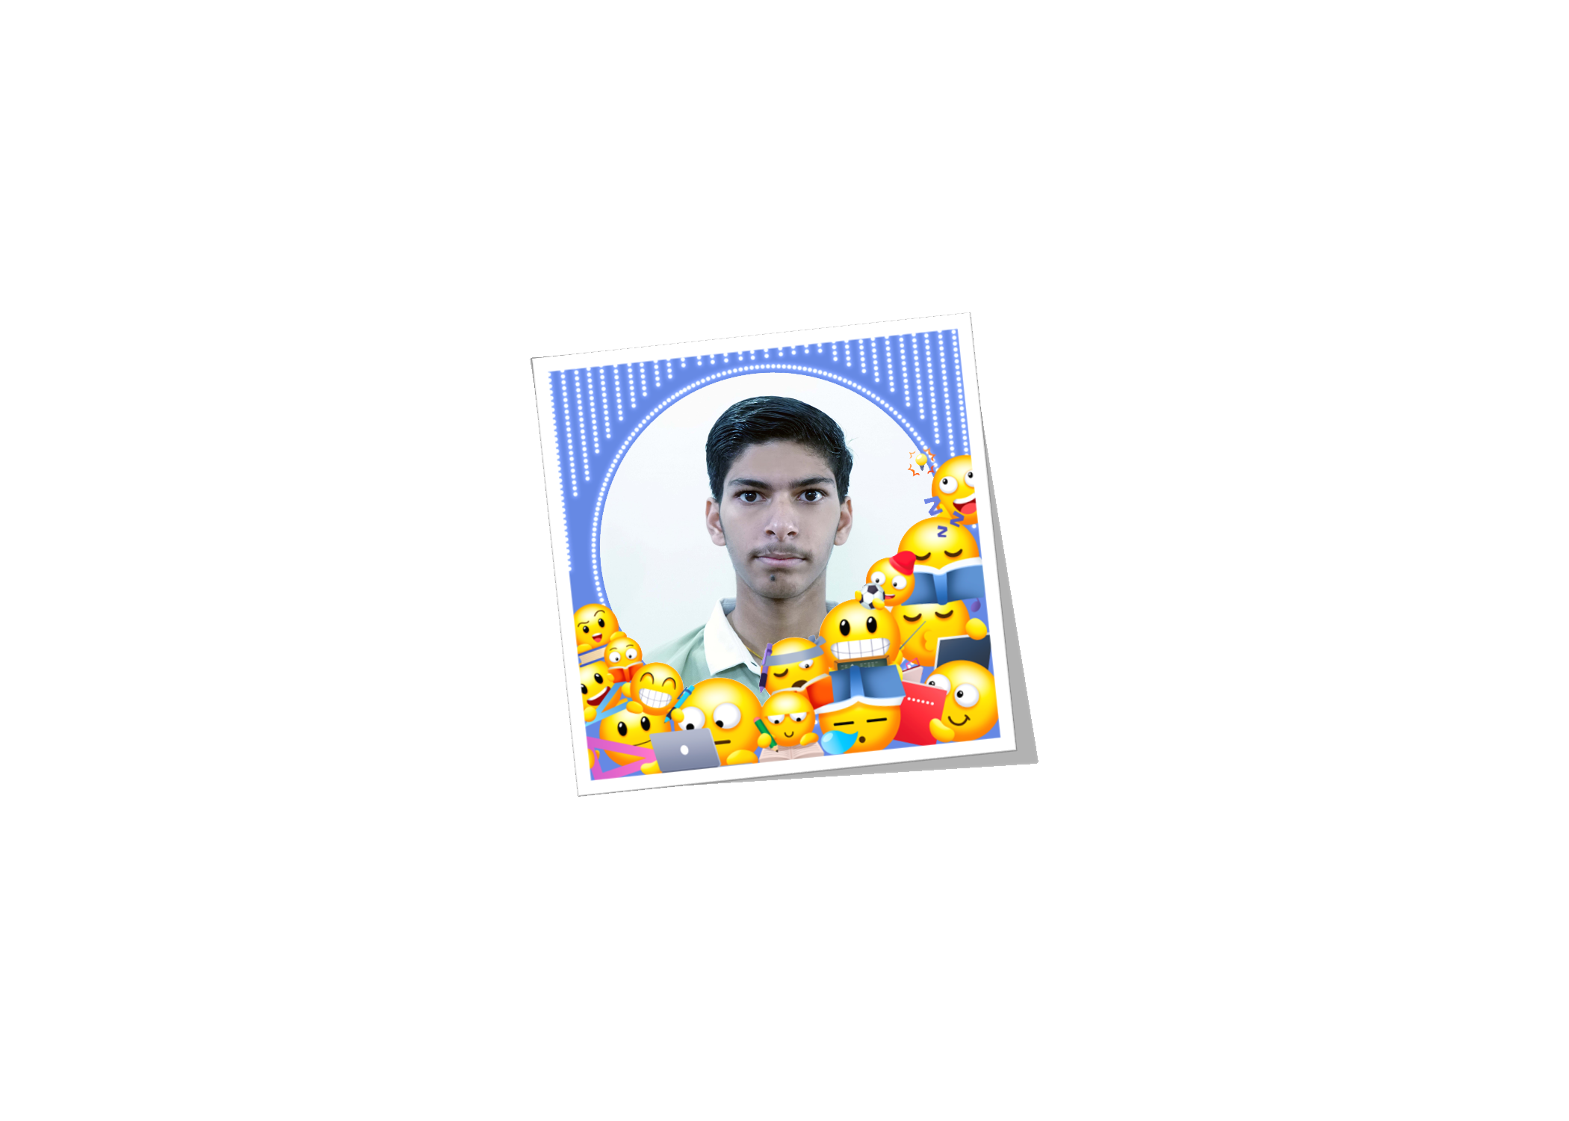
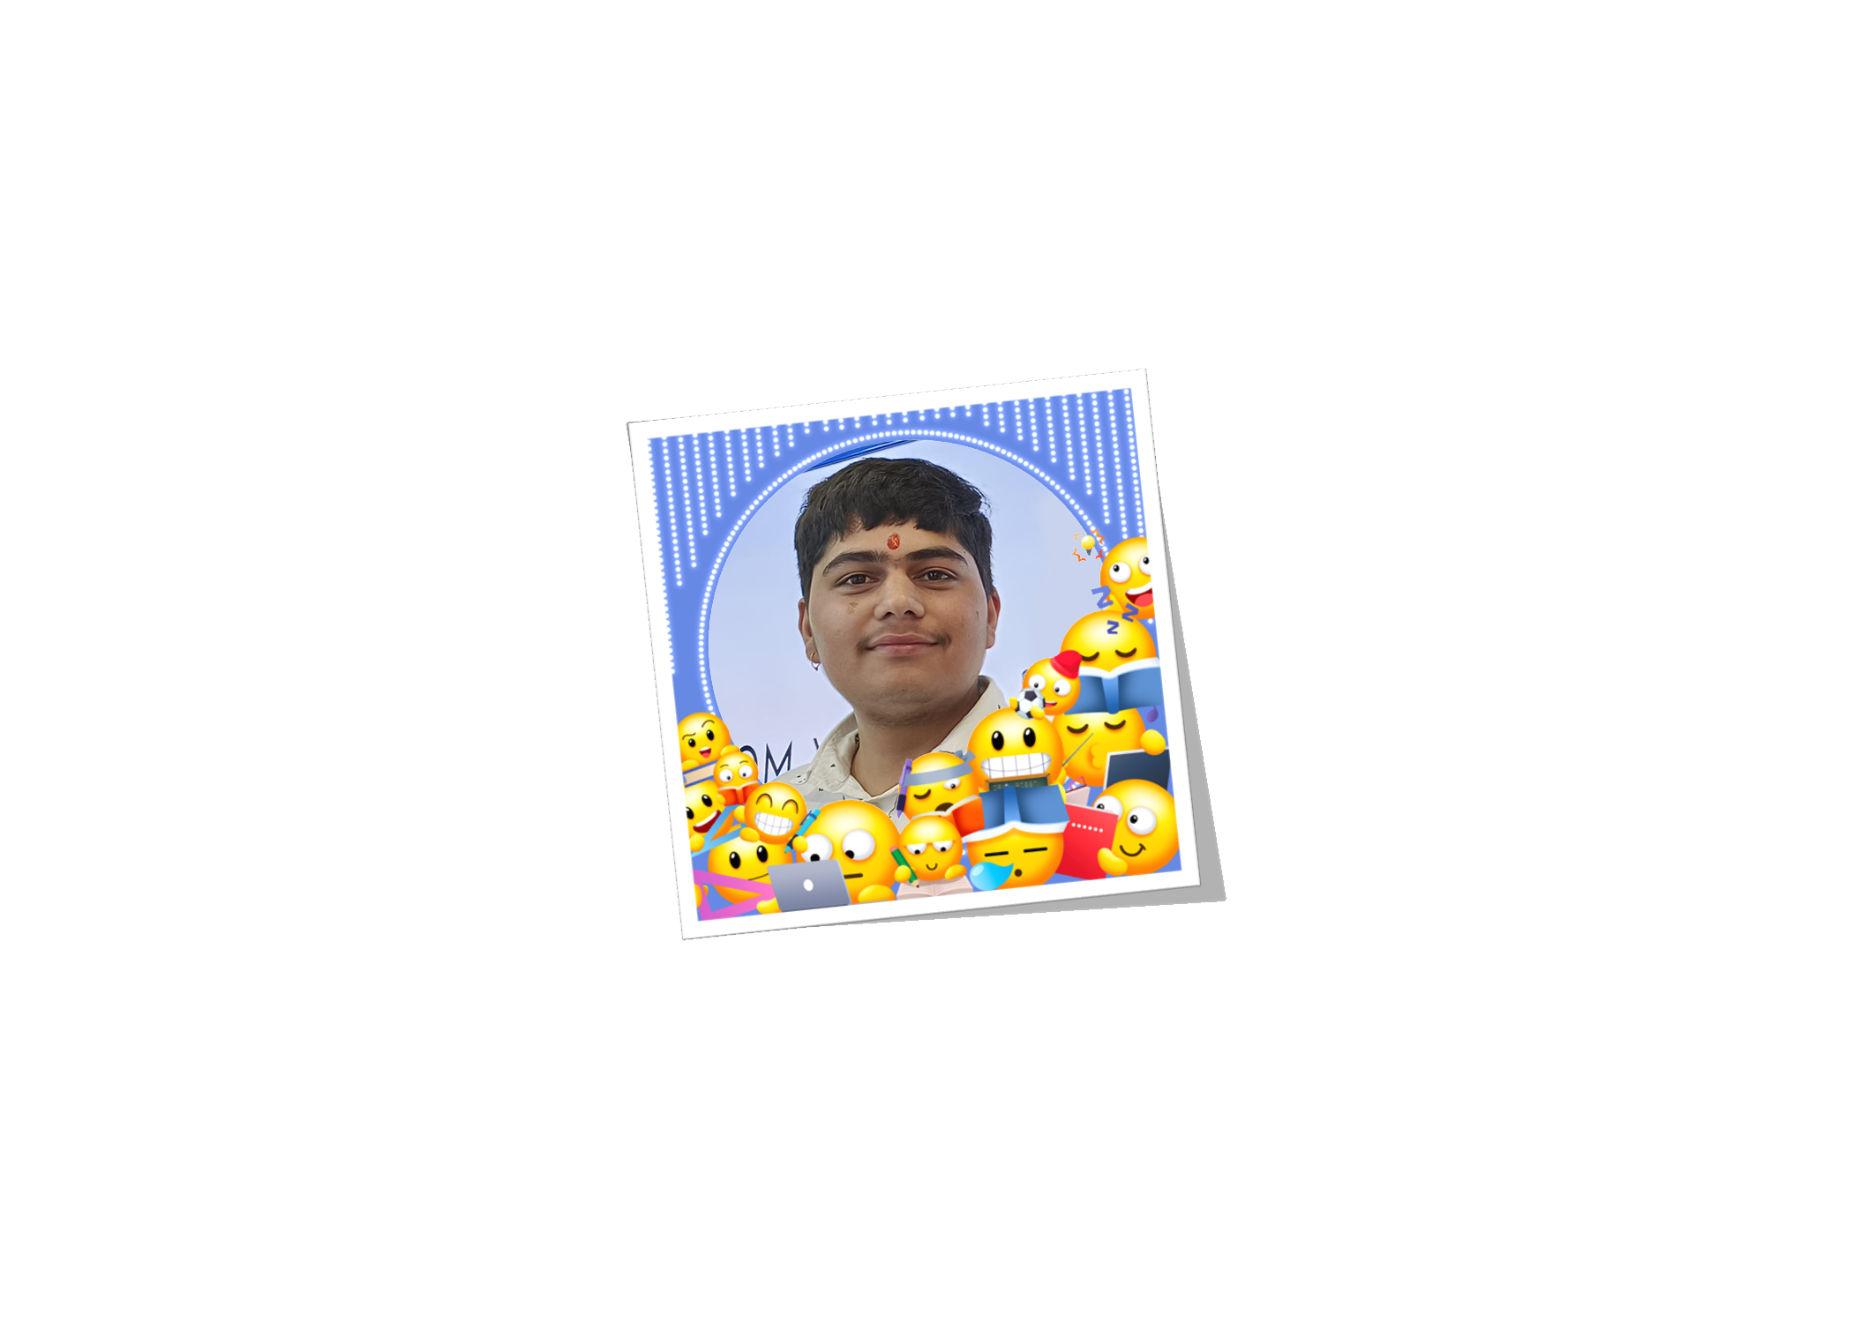


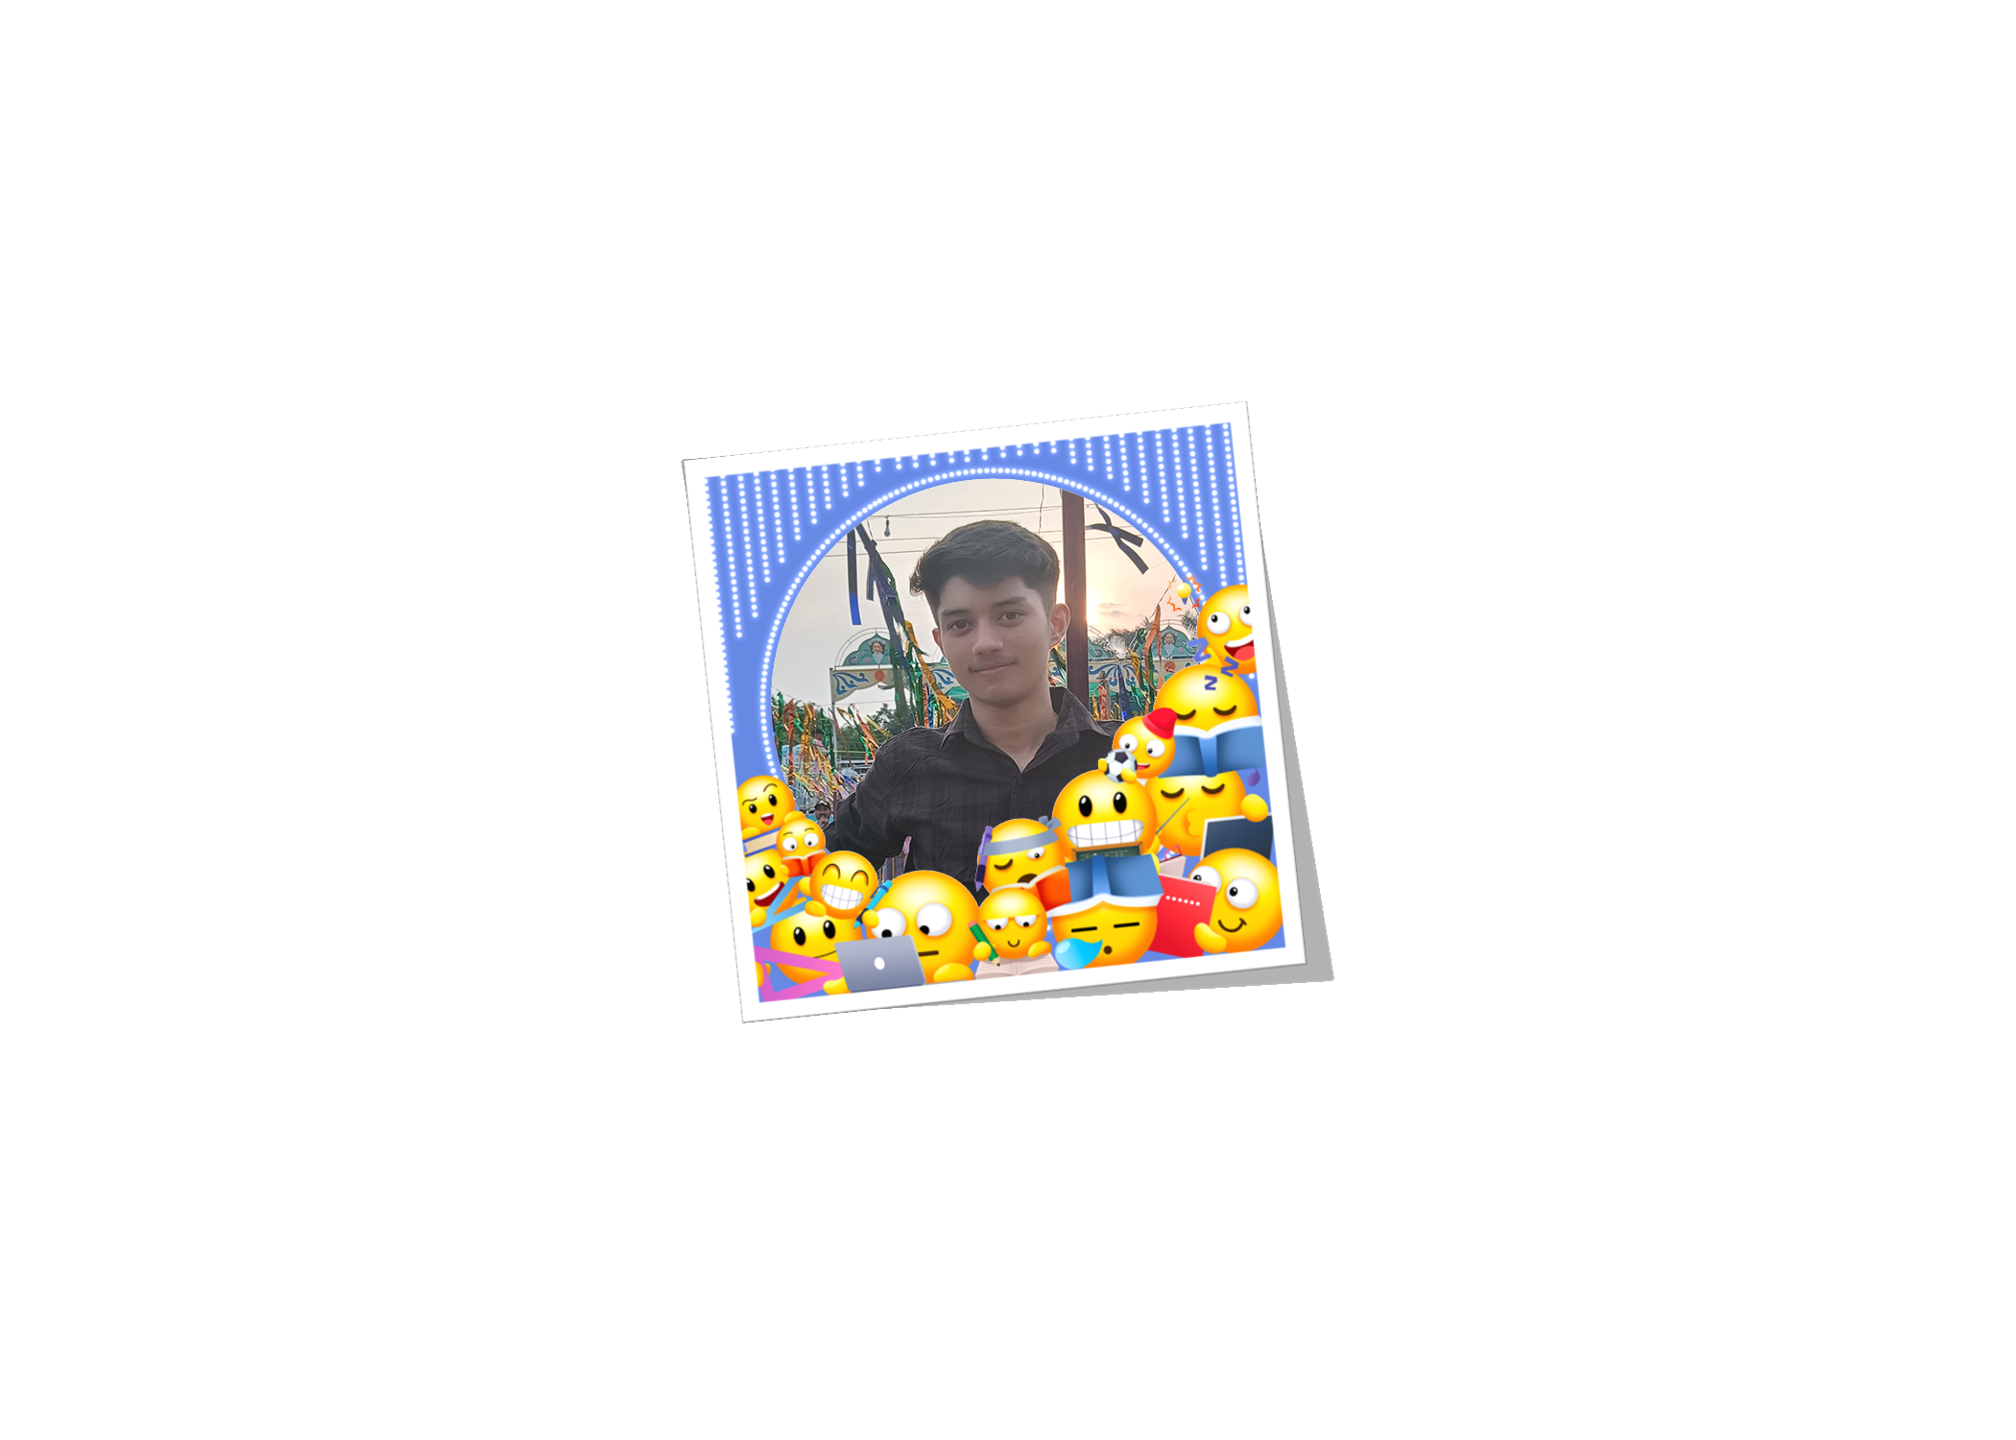
Our Team and Supports
Our team put in its best efforts to ensure you have an outstanding experience. Each member worked diligently to deliver top-quality results, making sure every step of the way exceeds your expectations.

Slide 10

Dedicated to Excellence: Crafting an Exceptional Experience, Every Step of the Way!

Slide 11


THANK YOU FOR LISTENING!
Don't hesitate to ask any questions!

